Slide 1
Compton effect

Slide 2
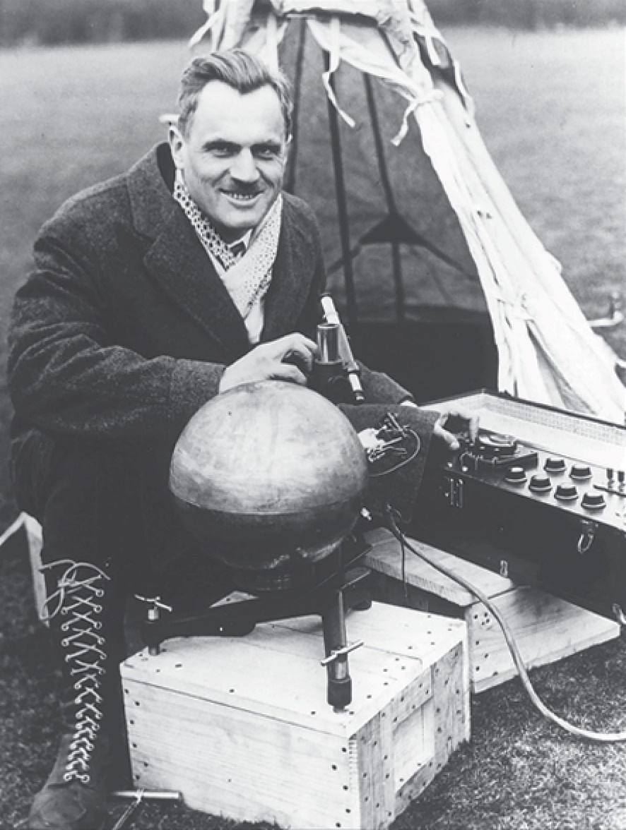
Arthur Holly Compton
1892 – 1962
American physicist
Director of the lab at the University of Chicago
Discovered the Compton Effect
Shared the Nobel Prize in 1927

Slide 3
The Compton Effect, Introduction
Compton and Debye extended Einstein’s idea of photon momentum.
The two groups of experimenters accumulated evidence of the inadequacy of the classical wave theory.
The classical wave theory of light failed to explain the scattering of x-rays from electrons.

Slide 4
Compton Effect, Classical Predictions
According to the classical theory, em waves incident on electrons should:
Have radiation pressure that should cause the electrons to accelerate
Set the electrons oscillating
There should be a range of frequencies for the scattered electrons.

Slide 5
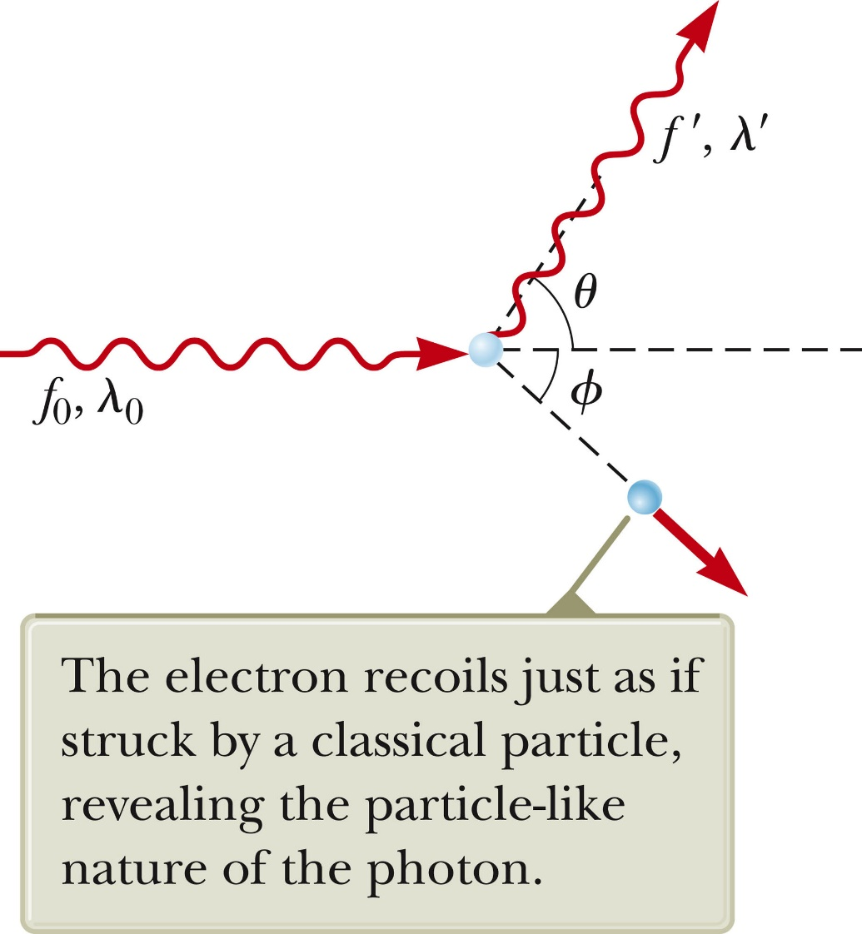
Compton Effect, Observations
Compton’s experiments showed that, at any given angle, only one frequency of radiation is observed.

Slide 6
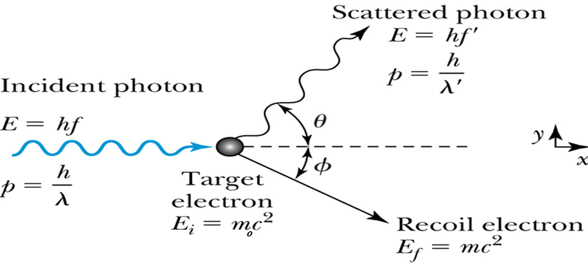
X-ray scattering: The Compton experiment

Slide 7
X-ray scattering: The Compton experiment
In the Compton experiment, x rays are scattered from electrons. The scattered x rays have a longer wavelength than the incident x rays, and the scattered wavelength depends on the scattering angle φ.
Explanation: When an incident photon collides with an electron, it transfers some of its energy to the electron. The scattered photon has less energy and a longer wavelength than the incident photon. These are elastic collisions, so both momentum and energy are conserved.

Slide 8
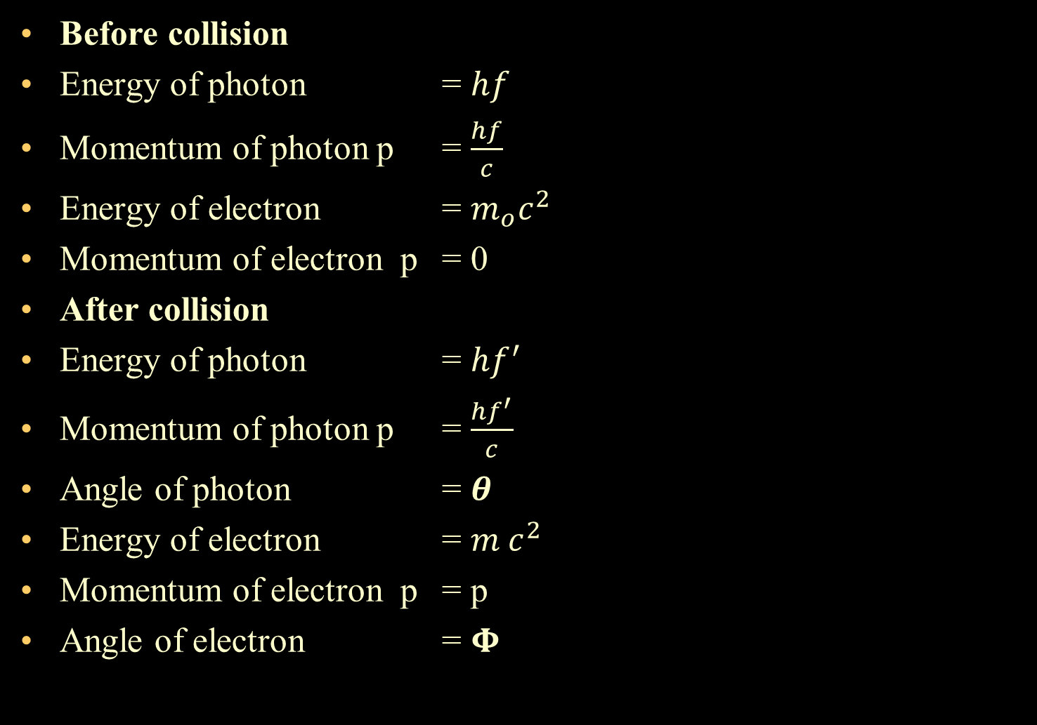
Compton Effect, Classical Predictions
Before collision
Energy of photon = $hf$
Momentum of photon p = $\frac{hf}{c}$
Energy of electron = $m_{o}c^{2}$
Momentum of electron p = 0
After collision
Energy of photon = $hf^{′}$
Momentum of photon p = $\frac{hf^{′}}{c}$
Angle of photon = $θ$
Energy of electron = ${m c}^{2}$
Momentum of electron p = p
Angle of electron = $Φ$

Slide 9
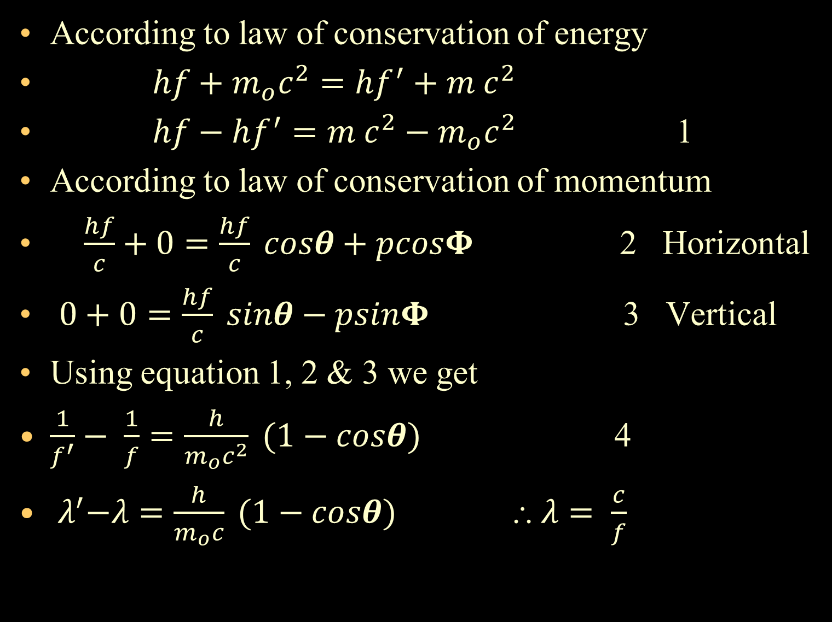
According to law of conservation of energy
$hf+m_{o}c^{2}=hf^{′}+{m c}^{2}$
$hf−hf^{′}={m c}^{2}−m_{o}c^{2}$ 1
According to law of conservation of momentum
$\frac{hf}{c}+0=\frac{hf}{c} cosθ+pcosΦ$ 2 Horizontal
$0+0=\frac{hf}{c} sinθ−psinΦ$ 3 Vertical
Using equation 1, 2 & 3 we get
$\frac{1}{f^{′}}− \frac{1}{f}=\frac{h}{m_{o}c^{2}} (1−cosθ)$ 4
${ λ}^{′}−λ=\frac{h}{m_{o}c} (1−cosθ)$ $⸫ λ= \frac{c}{f}$

Slide 10

Compton Wavelength
The factor h/m₀ c in the equation is called the Compton wavelength of the electron and is
The un shifted wavelength, λ_{o}, is caused by x-rays scattered from the electrons that are tightly bound to the target atoms.

Slide 11
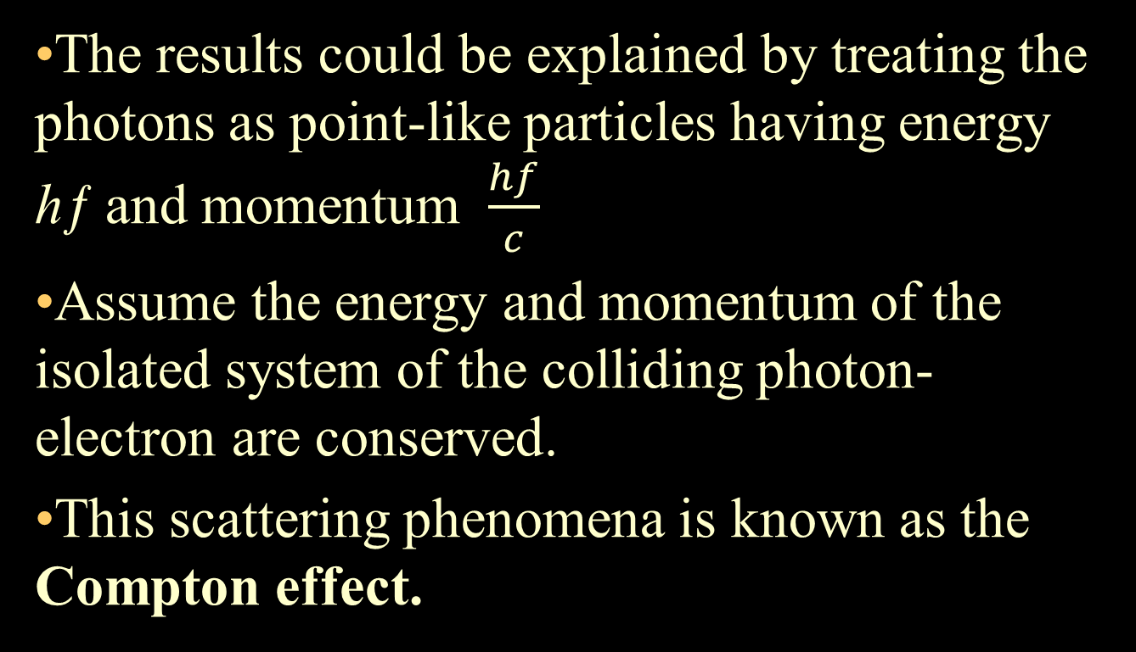
Compton Effect, Explanation
The results could be explained by treating the photons as point-like particles having energy hƒ and momentum $\frac{hf}{c}$
Assume the energy and momentum of the isolated system of the colliding photon-electron are conserved.
This scattering phenomena is known as the Compton effect.

Slide 12
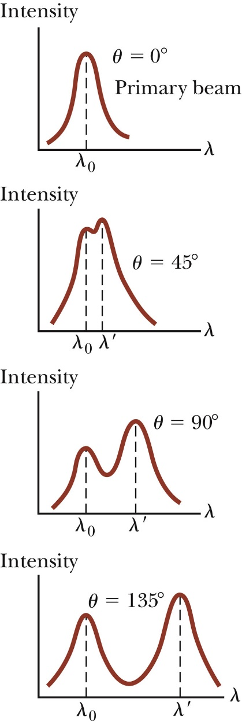
Compton Shift Equation
The graphs show the scattered x-rays for various angles.
The shifted peak, λ’, is caused by the scattering of free electrons.
This is called the Compton shift equation.

Slide 13
Limitation Visible light can not cause Compton Effect.
As the maximum Compton shift is 0.0484 Aº Hence Compton shift is insignificant for visible radiation. Therefore Compton Effect can be observed only when, the striking photon is highly energetic.
Scattering atom should be of low atomic no.
For higher atomic number , the number of loosely bound electrons are less , hence the probability of modified component is less Hence Compton shift is negligible . Therefore the intensity of unmodified component is large.
Explanation on the basis of Quantum theory
Modified Component – Elastic Collision of X-ray photon with free or loosely bound electron.
Unmodified Component - Collision of X-ray photon with tightly bound electron.
In this case whole atom is involved in the collision and hence m₀ (mass of electron) in the Compton shift is replaced by M (mass of atom). As M>> m₀ Compton shift is negligible. Hence unmodified components exists.

Slide 14
Failure of Classical Theory
According to classical wave theory, X-rays are regarded as electromagnetic waves of frequency
If these X-rays are incident on a material then it causes electron in the material to oscillate with the same frequency.
These electron reradiate with same frequency in the form of electromagnetic waves .
Hence, the scattered wave or radiation should have same wavelength as that of incident radiation.
Secondly electron radiate uniformly in all directions.
Wavelength of scattered radiation should not depend on scattering angle Φ.
Thus, Classical theory does not give the explanation of modified wavelength.

